Slide 1
Housing Price of California
Zhihao Li
Guanyu Chen
Haohan Zeng
Yunbai Zhang

Slide 2
Contents
01. Introduction
01-1. Google Trend
01-2. GDP graph
01-3. Davis Houses
02. Fitting Time Series Model
02-1. Pricing Diagnostic
02-2. Predict Price in 2017
03. Influential Factors
03-1. Income factor
03-2. Presentation title
04. Future Strategy

Slide 3
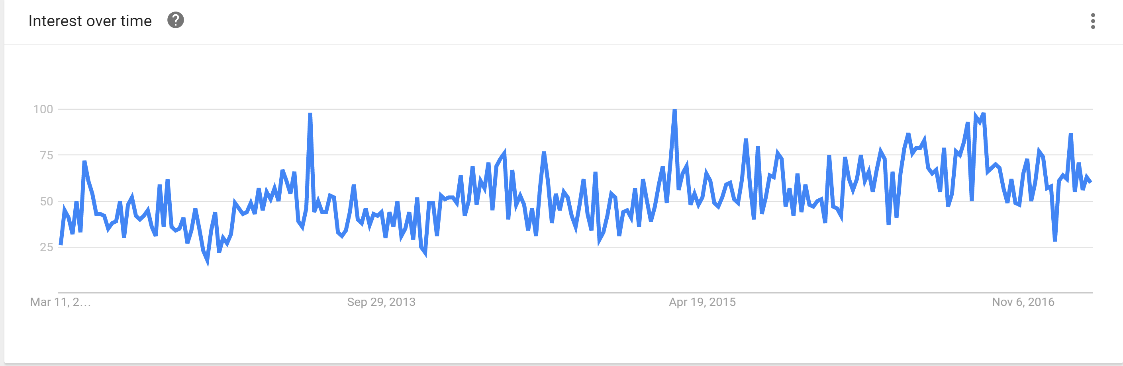
Google Trend
Housing Price from 2011-2016

Slide 4
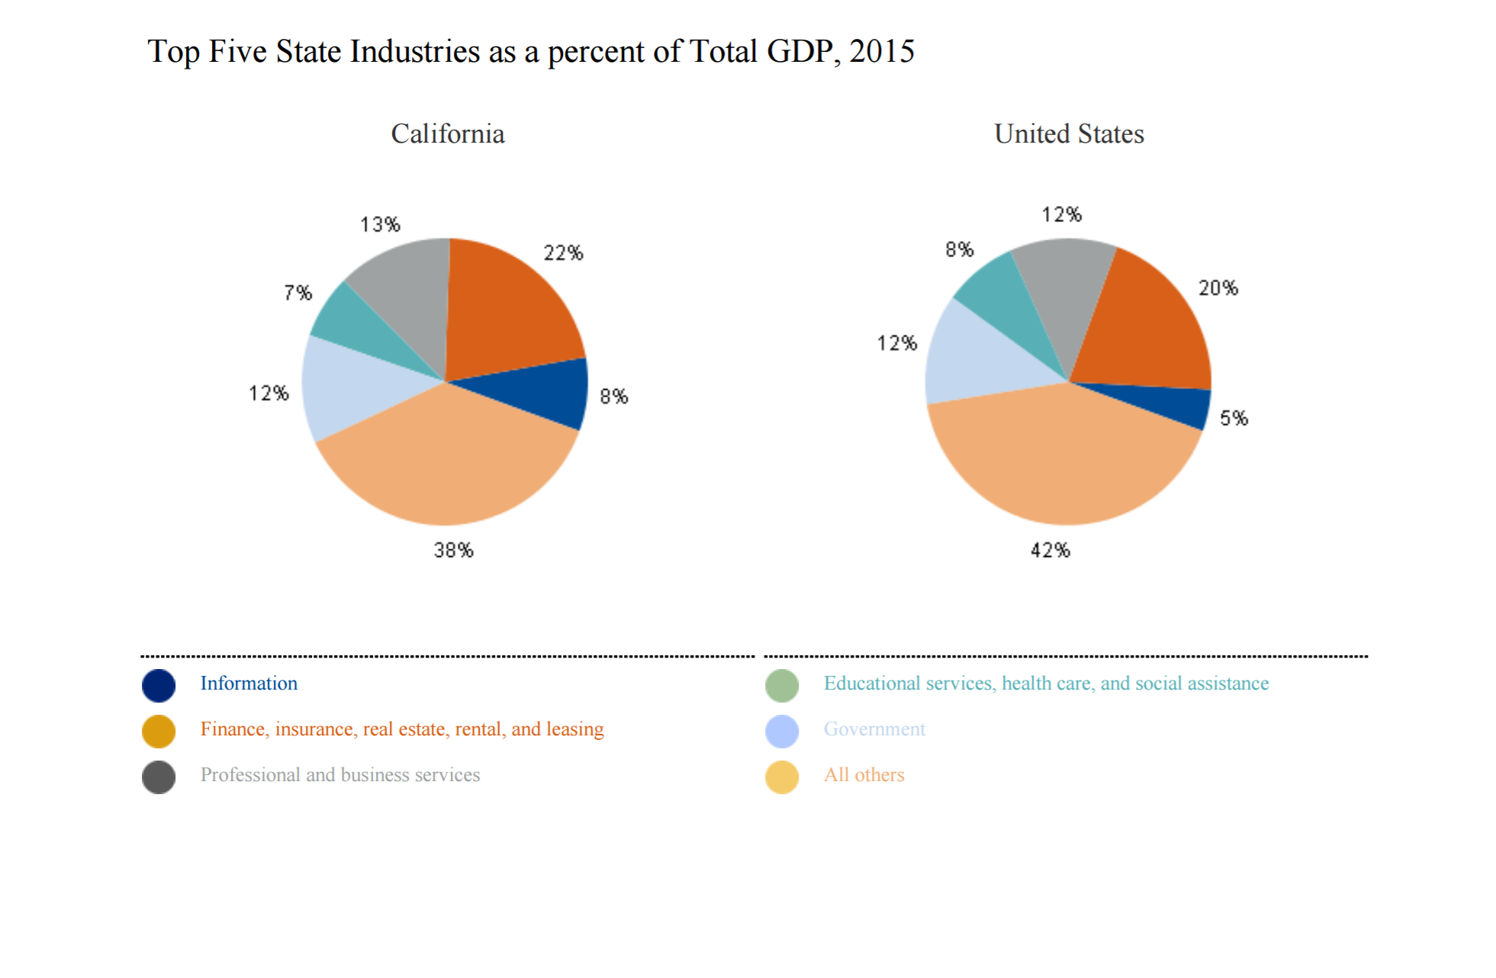
Real Estate Contributes to GDP
2015

Slide 5
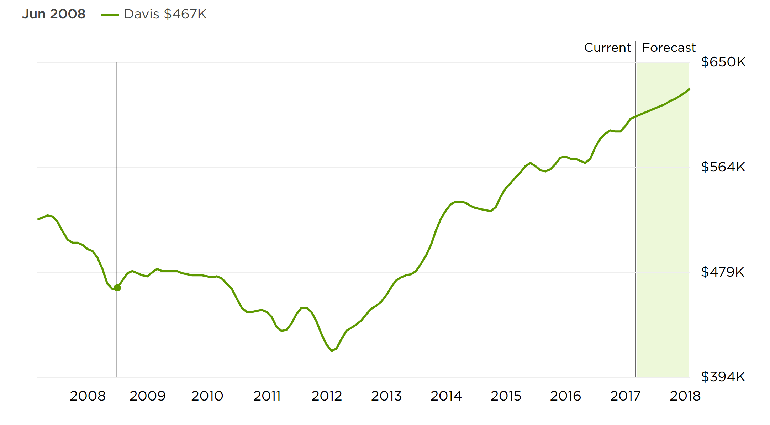

Davis Home Price Growth Trend
2008-2018

Slide 6
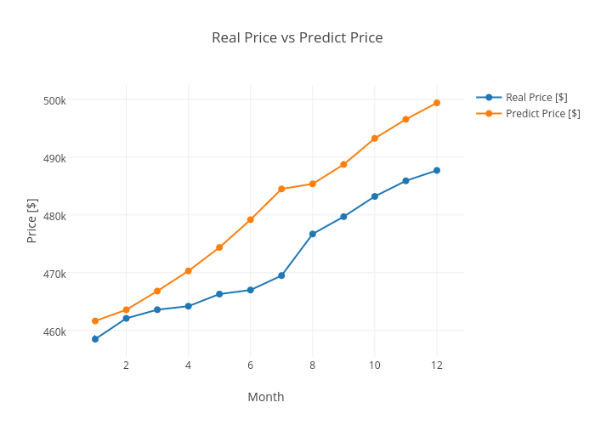
Diagnose of California Housing Price
Diagnostic Of Housing Price of 2016

Slide 7
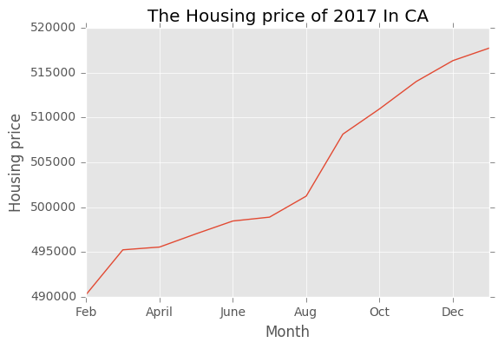
Prediction of Housing Price
2017

Slide 8
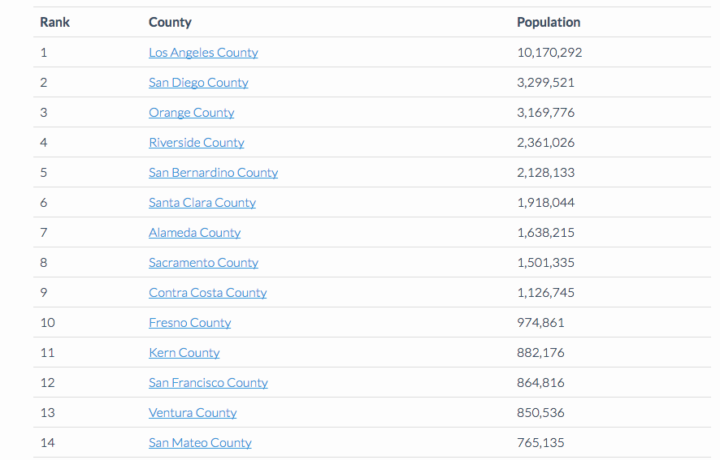
Large Cities in California
2016

Slide 9
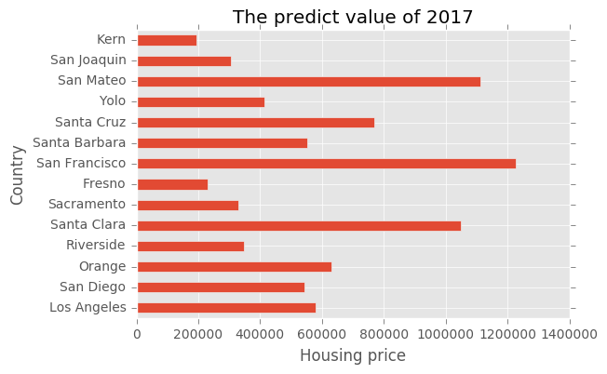
Predict housing price for large cities
Forecast

Slide 10
Three Factors may effect Housing Value
Housing supply and demand
Population Density
Income

Slide 11
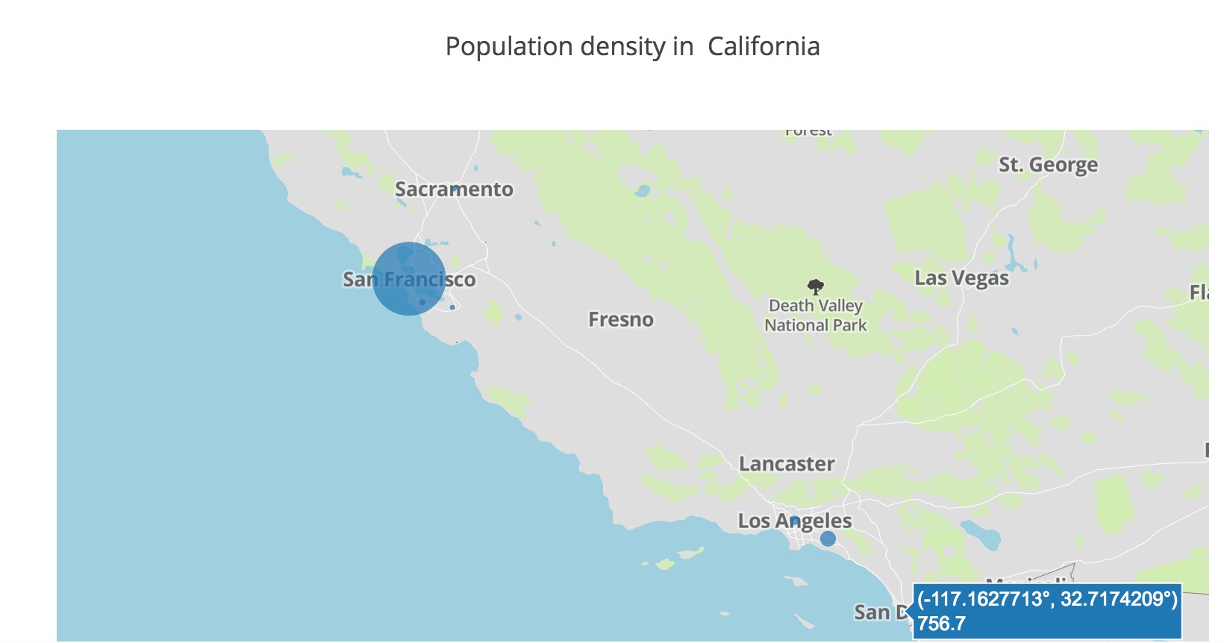
Population Density
Rank

Slide 12
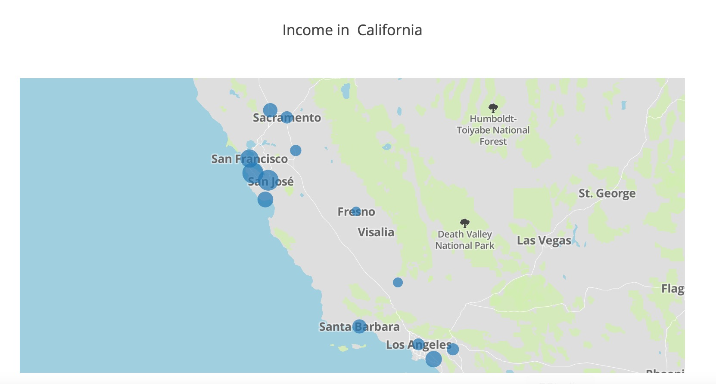
Income
Rank

Slide 13
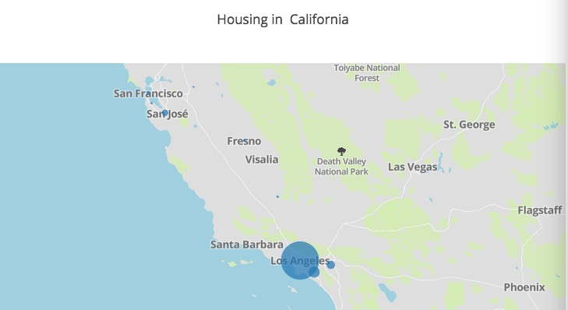
Housing Unit
Rank

Slide 14
Future Strategy
Focus more possible Factors from customers’ perspectives
Plot more graphs for geographs

